Slide 1
SUDOKU GRID GAME
USING PYTHON

Slide 2
Sudoku
Sudoku is a logic-based, combinatorial number-placement puzzle. In classic Sudoku, the objective is to fill a 9 × 9 grid with digits so that each column, each row, and each of the nine 3 × 3 sub grids that compose the grid contain all of the digits from 1 to 9
What is the purpose of the game Sudoku?
Sudoku is a logic based number placement puzzle. The objective is to fill a 9×9 grid so that each column, each row, and each of the nine 3×3 boxes (also called blocks or regions) contains the digits from 1 to 9, only one time each (that is, exclusively). The puzzle setter provides a partially completed grid
Sudoku Solver Algorithm
Your Sudoku Generator algorithm may need to use a Sudoku Solver Algorithm in order to test whether a generated grid is solvable and to check that it only gives a single solution.
The most common type of Sudoku Solver Algorithm is based on a backtracking algorithm used to investigate all possible solutions of a given grid.

Slide 3
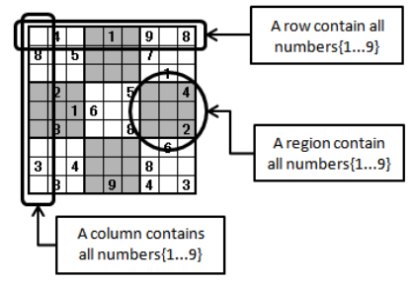
Backtracking algorithm
Backtracking is a type of depth-first search algorithm that can be used to find some or all solutions to a problem, and is often used for constraint satisfaction problems such as Sudoku or crossword puzzles, or the eight queens puzzle

Slide 4
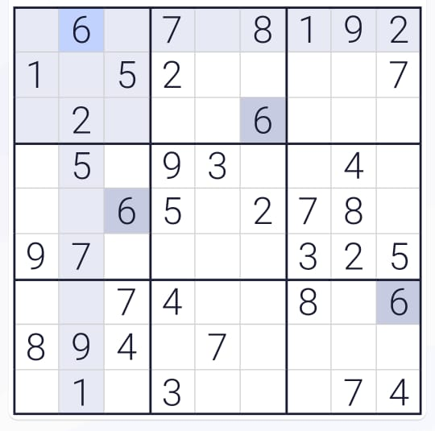
In Sudoku the constraints are:
each square must contain a number from 1-9
each number 1-9 can only occur once in a column, row, or 3x3 box
Backtracking is a brute force search algorithm that incrementally builds a solution, and backtracks when it takes a direction in the search path that will not lead to a solution.

Slide 6
'''0 means the cells where no value is assigned'''
grid = [[0, 6, 0, 7, 0, 8, 1, 9, 2],
[1, 0, 5, 2, 0, 0, 0, 0, 7],
[0, 2, 0, 0, 0, 6, 0, 0, 0],
[0, 5, 0, 9, 3, 0, 0, 4, 0],
[0, 0, 6, 5, 0, 2, 7, 8, 0],
[9, 7, 0, 0, 0, 0, 3, 2, 5],
[0, 0, 7, 4, 0, 0, 8, 0, 6],
[8, 9, 4, 0, 7, 0, 0, 0, 0],
[0, 1, 0, 3, 0, 0, 0, 7, 4]
]
if (Sudoku(grid, 0, 0)):
puzzle(grid)
else:
print("Solution does not exist:(")

Slide 7
Output :
4 6 3 7 5 8 1 9 2
1 8 5 2 9 3 4 6 7
7 2 9 1 4 6 5 3 8
2 5 8 9 3 7 6 4 1
3 4 6 5 1 2 7 8 9
9 7 1 8 6 4 3 2 5
5 3 7 4 2 9 8 1 6
8 9 4 6 7 1 2 5 3
6 1 2 3 8 5 9 7 4
Conclusion
That’s all for building a sudoku solver in Python! I hope you had fun reading through the article and learning how we implemented the code The conclusion of a Sudoku puzzle is when all the cells of the grid are filled with numbers in such a way that each column, each row, and each of the nine 3×3 sub-grids that compose the grid contains all of the digits from 1 to 9. This is done without repeating any numbers in a row, column or sub-grid. That’s all for building a sudoku solver in Python! I hope you had fun reading through the article and learning how we implemented the code

